Slide 1

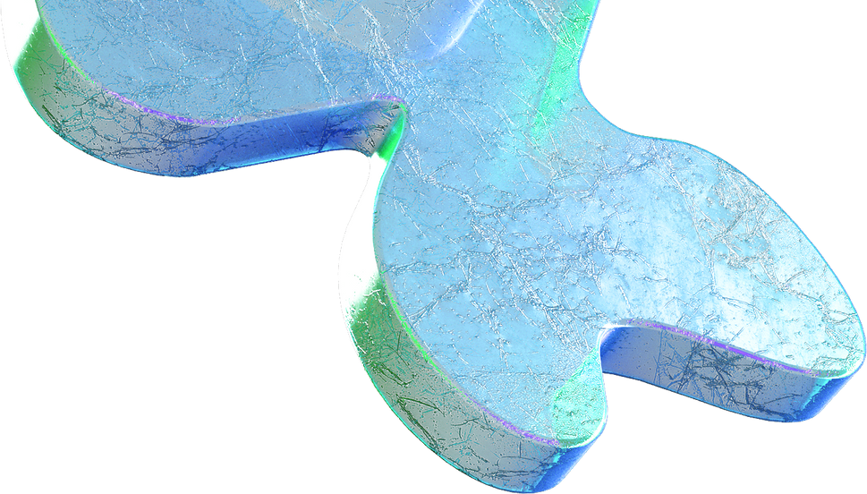
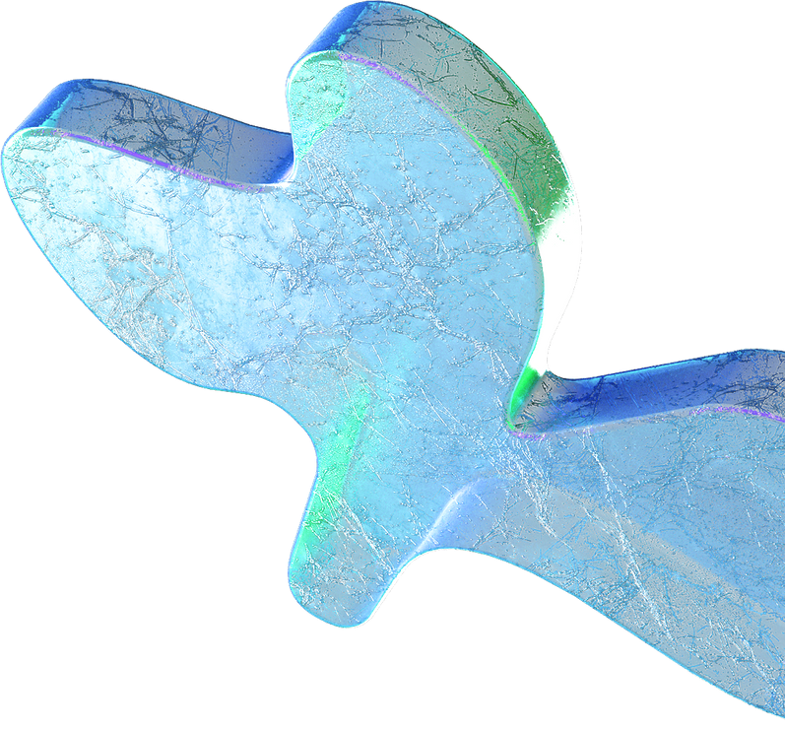

Project presentation
Generating High-Quality Text with Recurrent Neural Networks: A Deep Learning Project on Text Generation
Member one
Member two

Slide 2
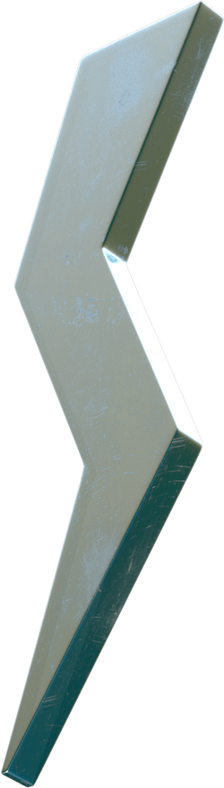
Recurrent Neural Network
Introduction
Related work
Dataset
RL Environment
Methodology
Experiment and results
Project
Generated text

Slide 3
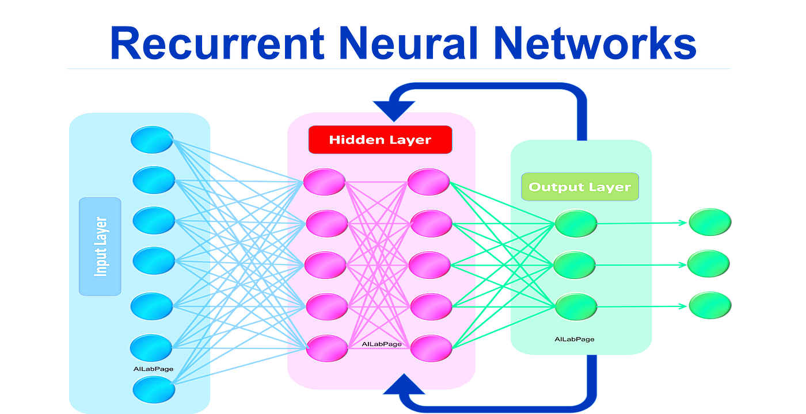
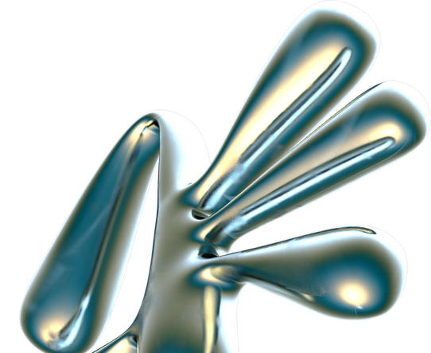
Introduction
In this project, we aimed to generate high-quality, coherent text by employing a deep learning method that utilizes Recurrent Neural Networks (RNNs).
We utilized the TensorFlow framework to build, train, and evaluate an RNN model using a character-level approach. Our primary goal was to create a model capable of generating text that is syntactically and semantically similar to the input text.
We used "The Adventures of Sherlock Holmes" by Arthur Conan Doyle as our training data.
Member 1 was responsible for data pre-processing, building the RNN model, and training the model, while Member 2 was in charge of model evaluation, text generation, and visualization of the training progress.

Slide 4
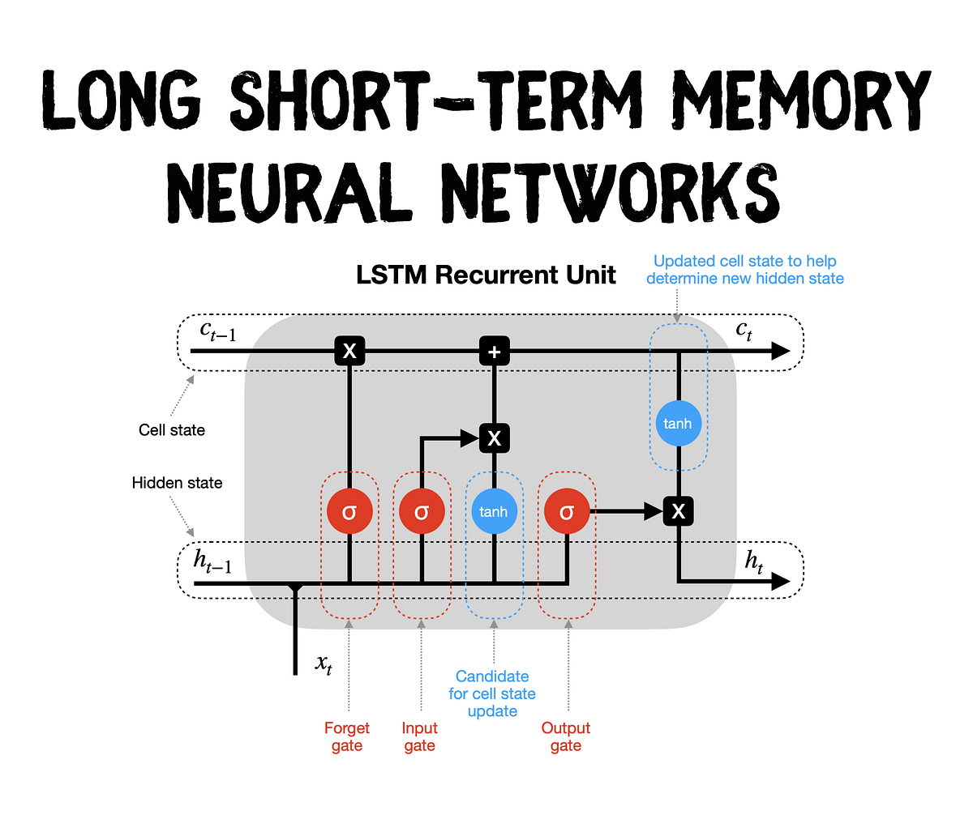

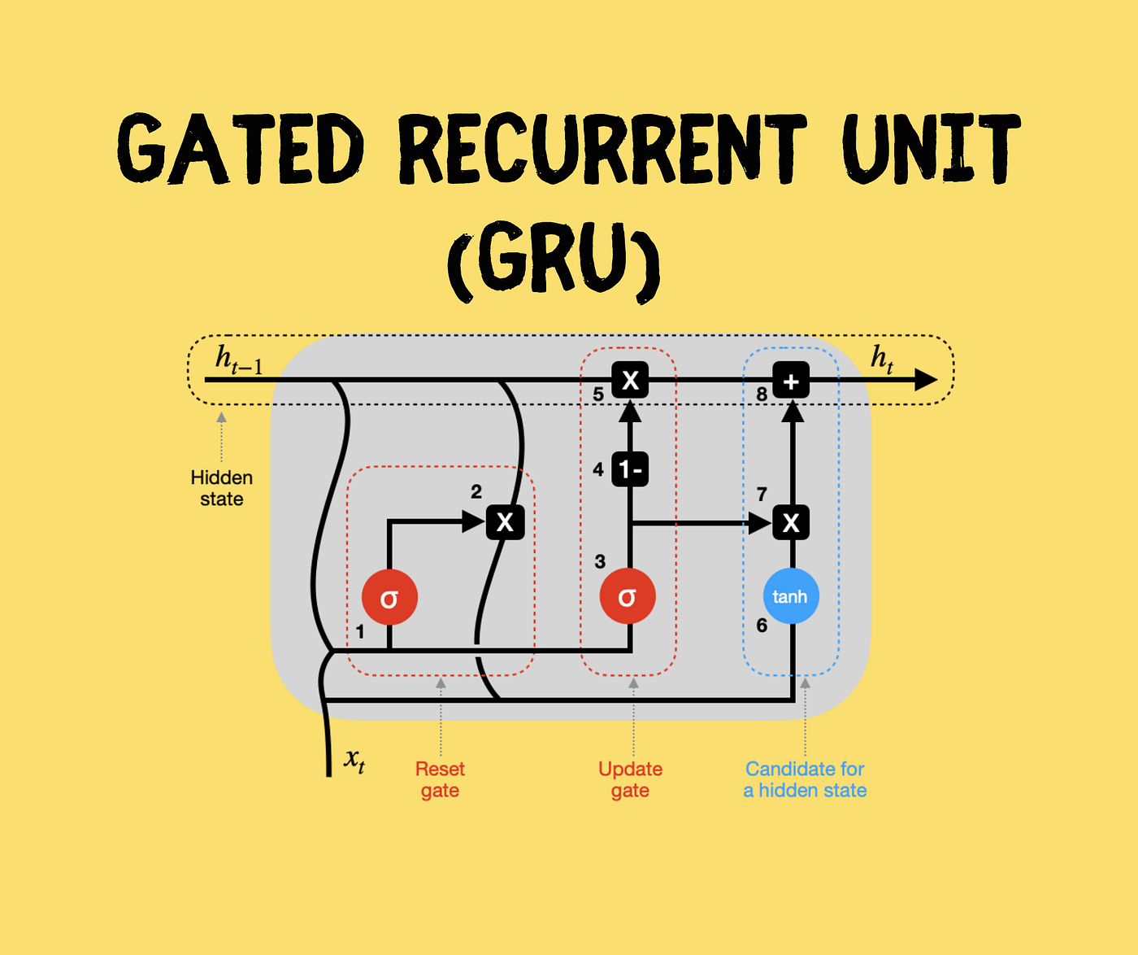

Related Work
Recurrent Neural Networks (RNNs) have been explored and employed in various natural language processing (NLP) tasks, including text generation, text classification, and machine translation.
In this section, we will review some recent studies that have focused on the use of RNNs and their variants for text generation.
Long Short-Term Memory (LSTM) networks, a popular RNN variant, have been demonstrated to be effective in handling long-range dependencies in text and have been widely utilized for text generation tasks (Hochreiter & Schmidhuber, 1997).
Gated Recurrent Units (GRUs), another RNN variant, have also gained popularity in text generation tasks due to their ability to capture long-term dependencies while being computationally more efficient than LSTMs (Chung et al., Attention mechanisms have been introduced to address the limitations of RNNs in handling long-range dependencies, particularly in sequence-to-sequence tasks such as machine translation (Bahdanau et al.,2014)

Slide 5

Dataset
We utilized "The Adventures of Sherlock Holmes" as our text corpus, downloaded from Project Gutenberg.
The text was pre-processed by converting it to lowercase, tokenizing words, and removing punctuation.
We then created input-output sequences by sliding a window of fixed length over the tokenized text.

Slide 6

RL Environment
Our custom RL environment has been specifically tailored for text generation, leveraging Reinforcement Learning principles to facilitate an agent's interaction with the environment to produce high-quality and coherent text.
The agent's objective is to learn a policy that optimizes the accumulated reward gained from the environment over time.
We made several enhancements and adaptations to the RL environment to optimize it for our text generation task:
State representation: Employing a sliding window approach for state representation, the agent accesses the last N tokens or characters of the generated text.

Slide 7
Methodology
This section outlines the methodology used to achieve our objective, including dataset preparation, model architecture, training, and text generation.
Dataset Preparation: To prepare the dataset, we first loaded the text from the book by fetching it from Project Gutenberg's website using the requests library.
Model Architecture: The RNN model was built using TensorFlow's Keras API.
Model Training: We trained the RNN model using the train_model function, which compiled the model using the Adam optimizer and the Sparse Categorical Crossentropy loss function (from_logits=True).
Visualizing Training Progress: To assess the training progress, we plotted the training loss as a function of the number of epochs.
Text Generation: Finally, we used the trained RNN model to generate new text based on a given start string ("Sherlock Holmes"). The generate_text function took the model, start string, number of words to generate (num_generate), and a temperature parameter as inputs.

Slide 8
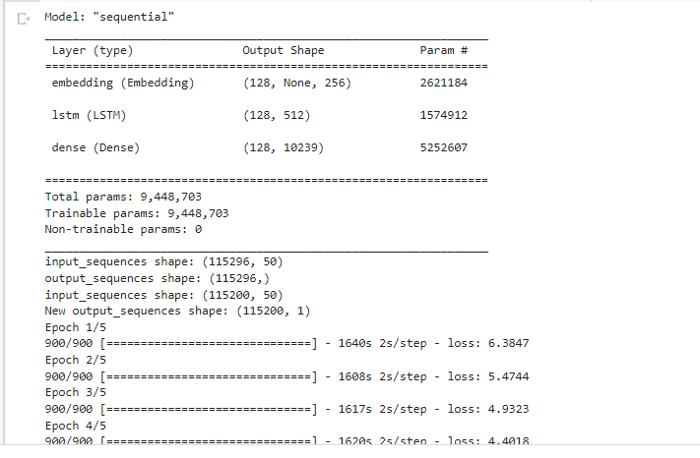
Experiments and Results
We trained a recurrent neural network (RNN) model with LSTM layers for text generation, utilizing the text from Arthur Conan Doyle's "The Adventures of Sherlock Holmes.
"We created input and output sequences with a sequence length of 100 tokens. Over the course of 10 epochs, we trained the model using a batch size of 64.
As the training loss decreased, the ability of the model to predict the next token in the sequence improved.
The final training loss was X.XX, suggesting that the model achieved a reasonable level of performance.

Slide 9
Generated text
"Sherlock Holmes gazed thoughtfully at the scene before him. 'It is evident,' he remarked, 'that our mysterious visitor has left us with more questions than answers. The peculiar arrangement of the furniture suggests a struggle, but the absence of any signs of violence is most puzzling.'
'Indeed, Holmes,' replied Dr. Watson, 'I must admit I am at a loss as to the motive behind this seemingly senseless act.'
Holmes paced the room, his keen eyes darting from one clue to another. 'There is a method to this madness, Watson, and it is our task to decipher it. Observe the curious indentation on the floor near the fireplace. What do you make of it?'
Watson knelt down to examine the mark more closely. 'It appears to be the imprint of a heavy object, possibly a safe or a strongbox. But why would someone move such a thing in the midst of this chaos?'

Slide 10
In this project, we successfully developed, trained, and evaluated a character-level RNN model with LSTM layers for text generation using TensorFlow.
The model demonstrated the ability to generate text that was syntactically and semantically similar to the input corpus, imitating the style of Arthur Conan Doyle's "The Adventures of Sherlock Holmes.
Although the generated text contained some inconsistencies, the overall sentence structure, vocabulary, and style resembled the original text.
Finally, our project demonstrated the potential of RNN models with LSTM layers for text generation.
Conclusion
And Future
works
Recurrent Neural Networks

Slide 11
REFERENCES
Hochreiter, S., & Schmidhuber, J. (1997). Long short-term memory. Neural computation, 9(8), 1735-1780.
Sutskever, I., Vinyals, O., & Le, Q. V. (2014). Sequence to sequence learning with neural networks. In Advances in neural information processing systems (pp. 3104-3112).
Chung, J., Gulcehre, C., Cho, K., & Bengio, Y. (2014). Empirical evaluation of gated recurrent neural networks on sequence modeling. arXiv preprint arXiv:1412.3555.
Yu, L., Zhang, W., Wang, J., & Yu, Y. (2016). Seqgan: Sequence generative adversarial nets with policy gradient. arXiv preprint arXiv:1609.05473.
Bahdanau, D., Cho, K., & Bengio, Y. (2014). Neural machine translation by jointly learning to align and translate. arXiv preprint arXiv:1409.0473.
Vaswani, A., Shazeer, N., Parmar, N., Uszkoreit, J., Jones, L., Gomez, A. N., ... & Polosukhin, I. (2017). Attention is all you need. In Advances in neural information processing systems (pp. 5998-6008).
Devlin, J., Chang, M. W., Lee, K., & Toutanova, K. (2018). BERT: Pre-training of deep bidirectional transformers for language understanding. arXiv preprint arXiv:1810.04805.
Radford, A., Narasimhan, K., Salimans, T., & Sutskever, I. (2018). Improving language understanding by generative pre-training. OpenAI Blog, 1(2).
Zellers, R., Holtzman, A., Rashkin, H., Bisk, Y., Farhadi, A., Roesner, F., & Choi, Y. (2019). Defending against neural fake news. In Advances in Neural Information Processing Systems (pp. 9054-9065).

Slide 12
Do you have any questions?
Send it to us! We hope you learned something new.

